Slide 1


Slide 2

LOGIC CIRCUIT
EXPRESSIONS
CIT 2nd Year- A ELT-2

Slide 3
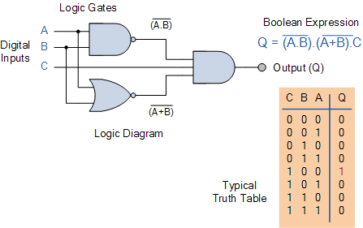
All three of these logic circuit representations are shown below.
CIT 2nd Year- A ELT-2

Slide 4
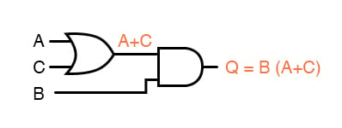
expression “B(A + C)”
CIT 2nd Year- A ELT-2

Slide 5
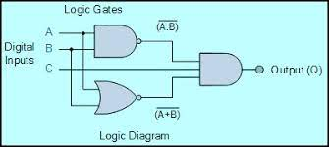

Slide 6
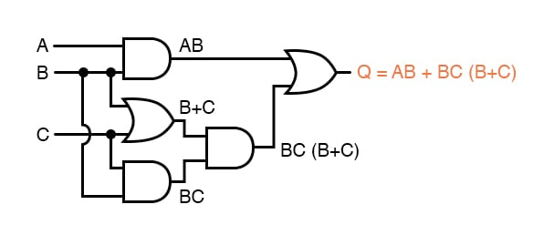
Q = AB + BC(B + C)
CIT 2nd Year- A ELT-2

Slide 7
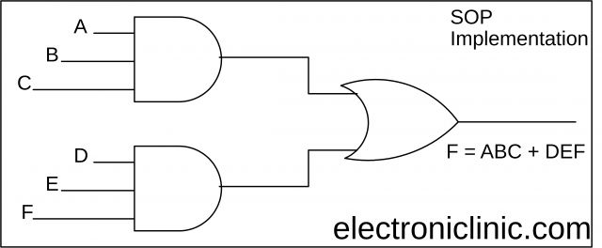
CIT 2nd Year- A ELT-2

Slide 8
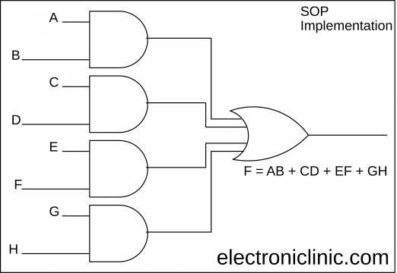
CIT 2nd Year- A ELT-2

Slide 9
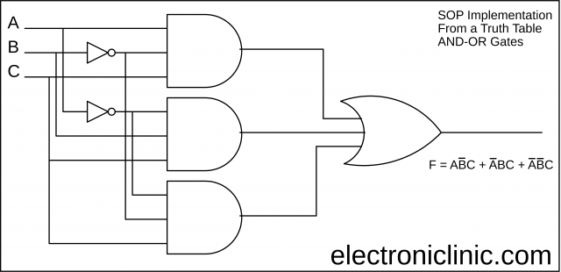
CIT 2nd Year- A ELT-2

Slide 10
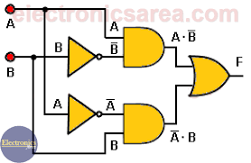
CIT 2nd Year- A ELT-2

